Slide 1
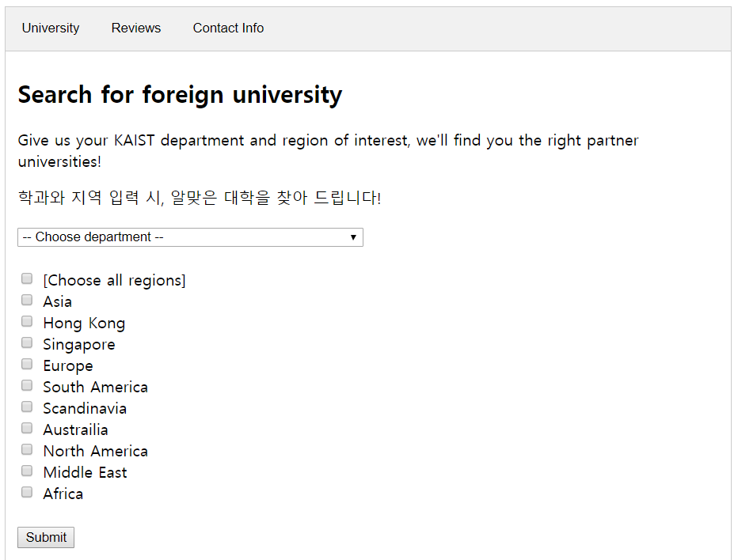
HOEP:
KAIST Helper for Outbound Exchange Program
Team 11 | Hyunchul Park, Jayeong Ryu, Jinwoo Kim

Slide 2



Why needed?
Outbound exchange program
Interest
Year

Slide 3
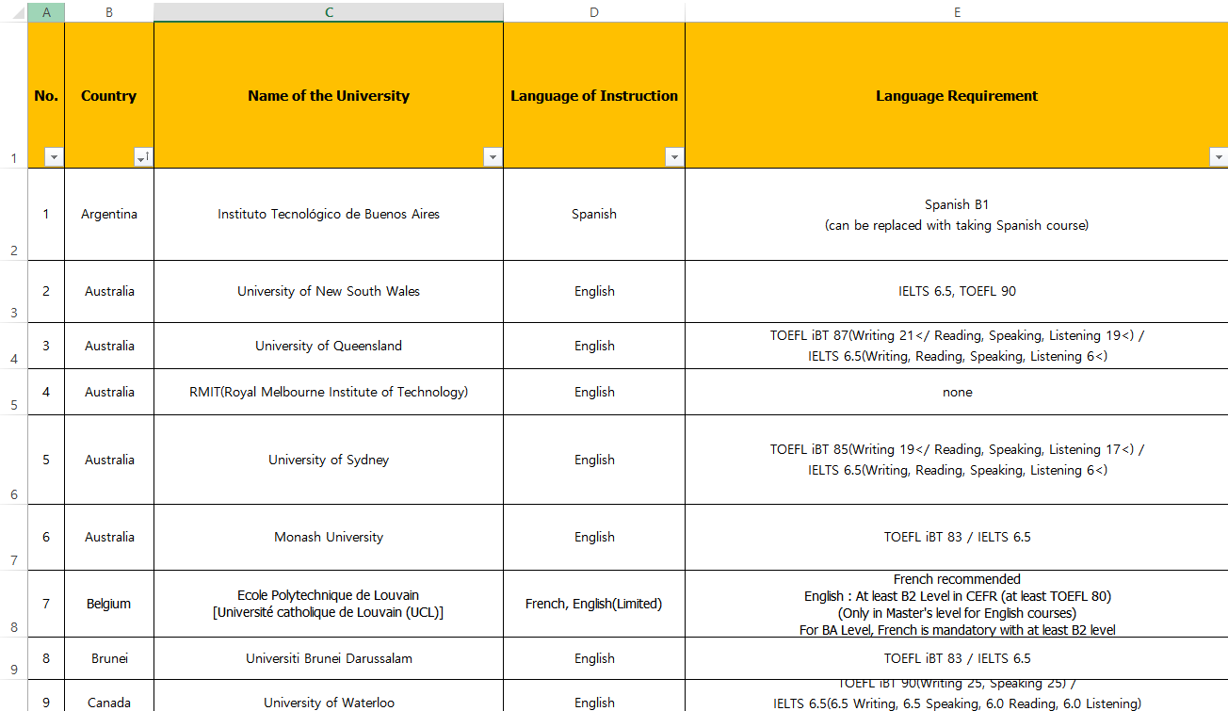
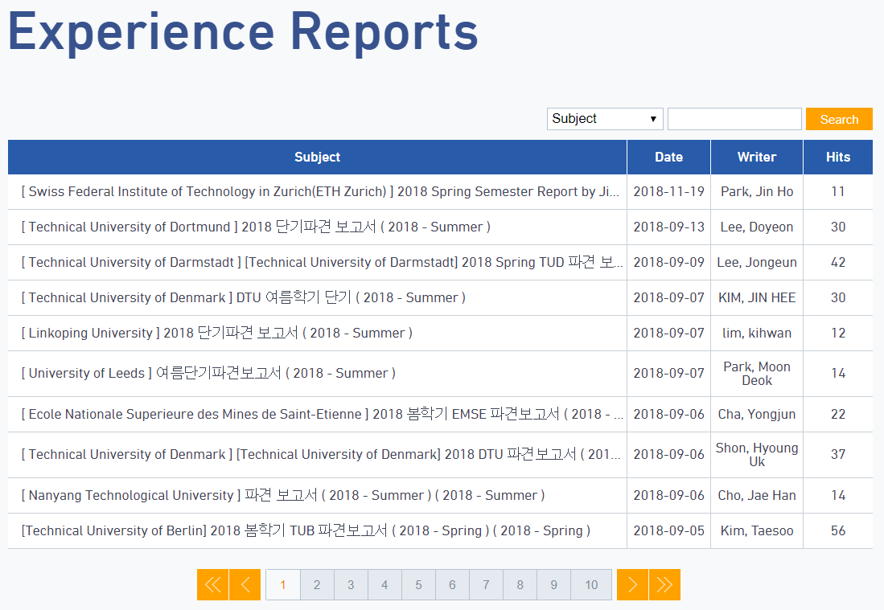
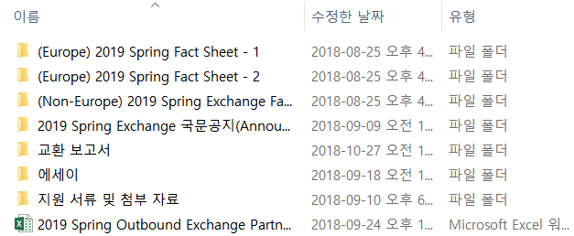
Why needed?
Information too fragmented!
Takes too much time to gather and overview

Slide 4
What if…
“Nupjuk Yi,
School of Computing,
Hopes to go to European university”
User information
Web UI
Display
Candidate partner universities
Opening (선발 인원)
Related departments
Language of instruction, prerequisite
Former exchange students’ reviews
KAIST IO manager of duty
Provided scholarship
Partner university DB
Providing immediate initial help for choosing partner university

Slide 5
Conceptual model (rough)
Attributes
Attributes
Attributes
IO manager
Partner university
Department (education track)
Scholarship
Former exchange student’s review
Language prerequisite
Attributes
Attributes
Attributes

Slide 6
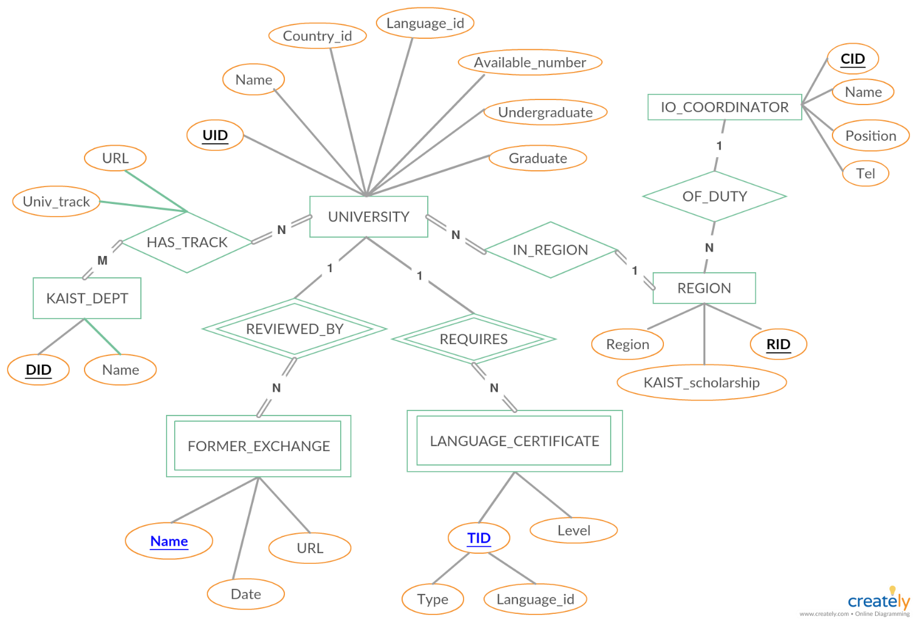
Conceptual model (ERD)
Primary key / Partial key

Slide 7
Relational schema
UNIVERSITY
UID | Name | Country_id | Language_id | Available_number | Undergraduate | Graduate | RID
REGION
IO_COORDINATOR
RID | Region | KAIST_scholarship | CID
CID | Name | Position | Tel
FORMER_EXCHANGE
LANGUAGE_CERTIFICATE
UID | Name | Date | URL
UID | Type | Language_id | Requisite
HAS_TRACK
KAIST_DEPT
UID | DID | Univ_track
DID | Name

Slide 8
Relational schema (FD: 2NF)
UNIVERSITY
UID | Name | Country_id | Language_id | Available_number | Undergraduate | Graduate | RID
REGION
IO_COORDINATOR
RID | Region | KAIST_scholarship | CID
CID | Name | Position | Tel
FORMER_EXCHANGE
LANGUAGE_CERTIFICATE
UID | Name | Date | URL
UID | Type | Language_id | Requisite
HAS_TRACK
KAIST_DEPT
UID | DID | Univ_track
DID | Name

Slide 9





Web programming scheme
1. Request
2. Query
Database
User Interface
Server
4. Response (html)
3. Result
User requests information through express framework (on Node.js runtime environment) and REST API (get/post..)
Server sends query to MySQL
Query/update result sent to server
HTML response sent to user through express API (res.send…)

Slide 10
Initial DB construction
DB definition
Base table definition
Data import
View definition (will be explained later)
CREATE DATABASE IF NOT EXISTS cs360_HOEP;
USE cs360_HOEP;
CREATE TABLE IF NOT EXISTS UNIVERSITY (
UID INT PRIMARY KEY,
Name VARCHAR(100) NOT NULL,
Country_id VARCHAR(20),
Language_id VARCHAR(20),
Available_number INT NOT NULL,
Undergraduate INT NOT NULL,
Graduate INT NOT NULL,
RID INT NOT NULL,
Region VARCHAR(20) NOT NULL
);
CREATE TABLE IF NOT EXISTS FORMER_EXCHANGE (
UID INT,
Univ_name VARCHAR(100) NOT NULL,
Name VARCHAR(30),
Post_date Date NOT NULL,
URL VARCHAR(500) NOT NULL,
PRIMARY KEY(UID, Name)
);
…
LOAD DATA INFILE
'C:/CS360-HOEP-Project/csv_data/UNIVERSITY.csv'
INTO TABLE UNIVERSITY
FIELDS TERMINATED BY ','
ignore 1 lines;
LOAD DATA INFILE 'C:/CS360-HOEP-Project/csv_data/FORMER_EXCHANGE.csv'
INTO TABLE FORMER_EXCHANGE
FIELDS TERMINATED BY ','
ignore 1 lines;
…

Slide 11
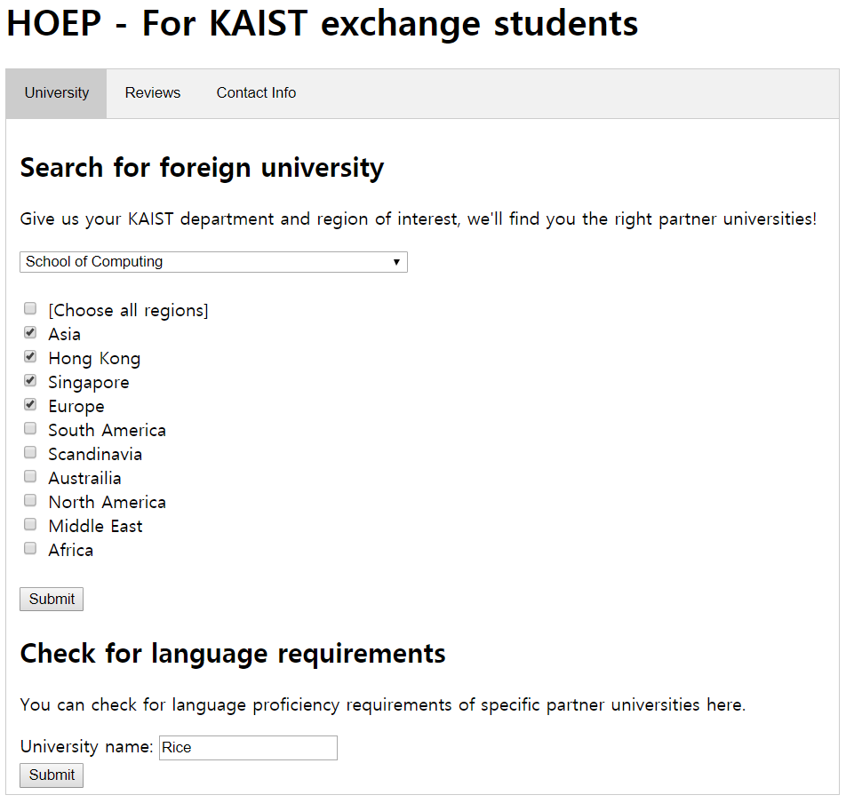
Time for actual demonstration…

Slide 12
Main tab 1-1
Dept, region user input
Univ name, track, country, language, TO, scholarship

Slide 13
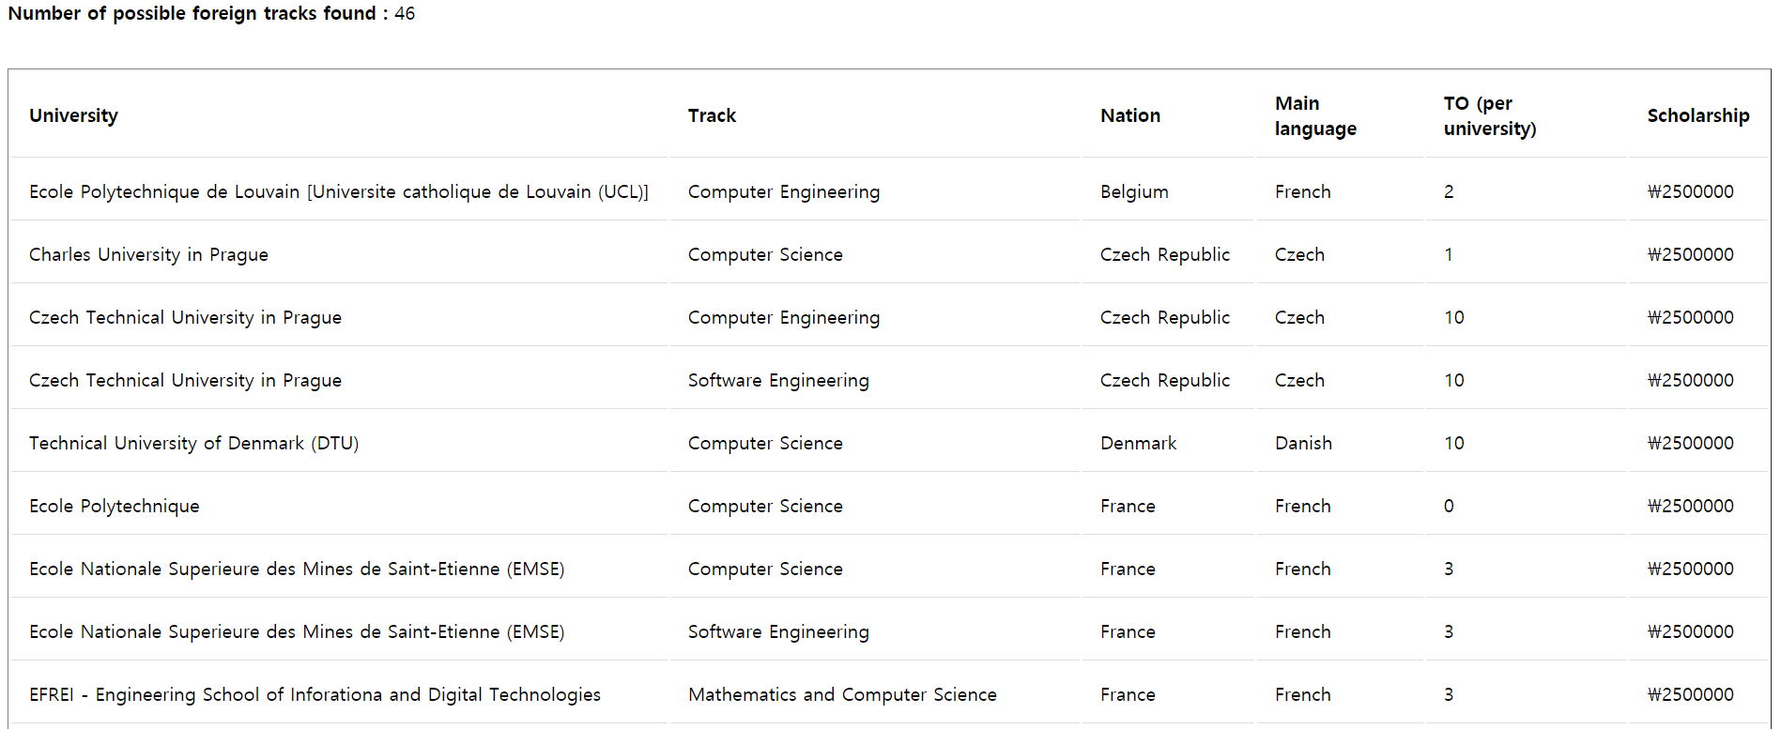
Main tab 1-1
University names
(may overlap)
Education tracks
Supplementary information

Slide 14
Main tab 1-1
UNIVERSITY
UID | Name | Country_id | Language_id | Available_number | Undergraduate | Graduate | RID
1 | Instituto Tecnologico de Buenos Aires | Argentina | Spanish | 4 | 1 | 1 | 5
2 | University of New South Wales | Austrailia | English | 4 | 1 | 1 | 7
3 | University of Queensland | Austrailia | English | 2 | 1 | 1 | 7
4 | RMIT(Royal Melbourne Institute of Technology) | Austrailia | English | 4 | 1 | 0 | 7
5 | University of Sydney | Austrailia | English | 10 | 1 | 1 | 7
6 | Monash University | Austrailia | English | 5 | 1 | 1 | 7
7 | Ecole Polytechnique de Louvain [Universite catholique de Louvain (UCL)] | Belgium | French | 2 | 1 | 1 | 4
8 | Universiti Brunei Darussalam | Brunei | English | 2 | 1 | 1 | 1
9 | University of Waterloo | Canada | English | 5 | 1 | 1 | 8
… | … | … | … | … | … | … | …
HAS_TRACK
REGION
UID | DID | Univ_track
1 | 2 | Bioengineering
1 | 4 | Chemical Engineering
1 | 15 | Computer Science
1 | 16 | Electrical and Electronic Engineering
1 | 14 | Finance
1 | 7 | Industrial Engineering
1 | 10 | Mathematics
1 | 11 | Mechanical Engineering
1 | 13 | Physics
2 | 2 | Biomedical Engineering
… | … | …
RID | Region | KAIST_scholarship | CID
1 | Asia | 1500000 | 6
2 | Hong Kong | 1700000 | 6
3 | Singapore | 1700000 | 6
4 | Europe | 2500000 | 3
5 | South America | 2500000 | 3
6 | Scandinavia | 2750000 | 3
7 | Austrailia | 2750000 | 6
8 | North America | 2750000 | 3
9 | Middle East | 0 | 8
10 | Africa | 0 | 8
(User input: DID, RID)

Slide 15
Main tab 1-1
'SELECT A.Name as Univ_name, B.Univ_track as Dept,
A.Country_id, A.Language_id, A.Available_number, B.Scholarship
FROM UNIVERSITY AS A
INNER JOIN
(SELECT TRACK_N_UNIV.UID as UID,
TRACK_N_UNIV.Univ_track as Univ_track,
REGION.KAIST_scholarship as Scholarship
FROM (TRACK_N_UNIV INNER JOIN REGION USING (RID))
WHERE DID = ‘ + req.body.user_dept + ‘ AND RID IN ‘ + region_str_set + ’) AS B
USING (UID)
WHERE Undergraduate = 1;’
Subquery -> Main query
(Inline view)
DID, RID
condition given by
WHERE statement
“Open to undergraduates” condition given by
WHERE statement
Join by region
REGION
Scholarship info.
Projection
Univ name, track, country, language, TO, scholarship
HAS_TRACK
TRACK_N_UNIV
(View table)
Projection
UNIVERSITY
UNIVERSITY
Join by univ.
Join by univ.

Slide 16
Main tab 1-1
Aggregation
‘SELECT COUNT(*) AS Count
FROM TRACK_N_UNIV
WHERE DID = ‘ + req.body.user_dept + ‘ AND RID IN ‘ + region_str_set

Slide 17
Main tab 1-2
Keyword user input
Univ name, test type, language, requisite

Slide 18
Main tab 1-2
LANGUAGE_CERTIFICATE
UID | Type | Language_id | Requisite
1 | CEFR | Spanish | B1
2 | IELTS | English | 6.5
2 | iBT-TOEFL | English | 90
3 | iBT-TOEFL | English | 87
3 | IELTS | English | 6.5
5 | iBT-TOEFL | English | 85
6 | iBT-TOEFL | English | 83
6 | IELTS | English | 6.5
… | … | … | …
Join, select tuples of given UID and project
UNIVERSITY
UID | Name | Country_id | Language_id | Available_number | Undergraduate | Graduate | RID
1 | Instituto Tecnologico de Buenos Aires | Argentina | Spanish | 4 | 1 | 1 | 5
2 | University of New South Wales | Austrailia | English | 4 | 1 | 1 | 7
3 | University of Queensland | Austrailia | English | 2 | 1 | 1 | 7
4 | RMIT(Royal Melbourne Institute of Technology) | Austrailia | English | 4 | 1 | 0 | 7
5 | University of Sydney | Austrailia | English | 10 | 1 | 1 | 7
6 | Monash University | Austrailia | English | 5 | 1 | 1 | 7
7 | Ecole Polytechnique de Louvain [Universite catholique de Louvain (UCL)] | Belgium | French | 2 | 1 | 1 | 4
8 | Universiti Brunei Darussalam | Brunei | English | 2 | 1 | 1 | 1
9 | University of Waterloo | Canada | English | 5 | 1 | 1 | 8
… | … | … | … | … | … | … | …

Slide 19
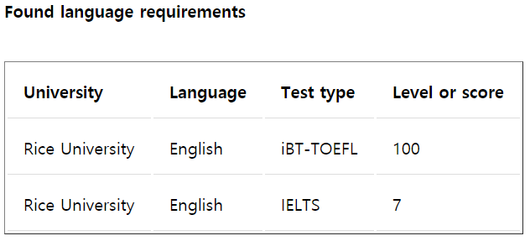
Main tab 1-2
"SELECT A.Name, Type, B.Language_id as Language, Requisite
FROM (UNIVERSITY AS A
INNER JOIN
LANGUAGE_CERTIFICATE AS B
USING (UID))
WHERE A.Name LIKE '%" + req.body.univ + "%';"

Slide 20
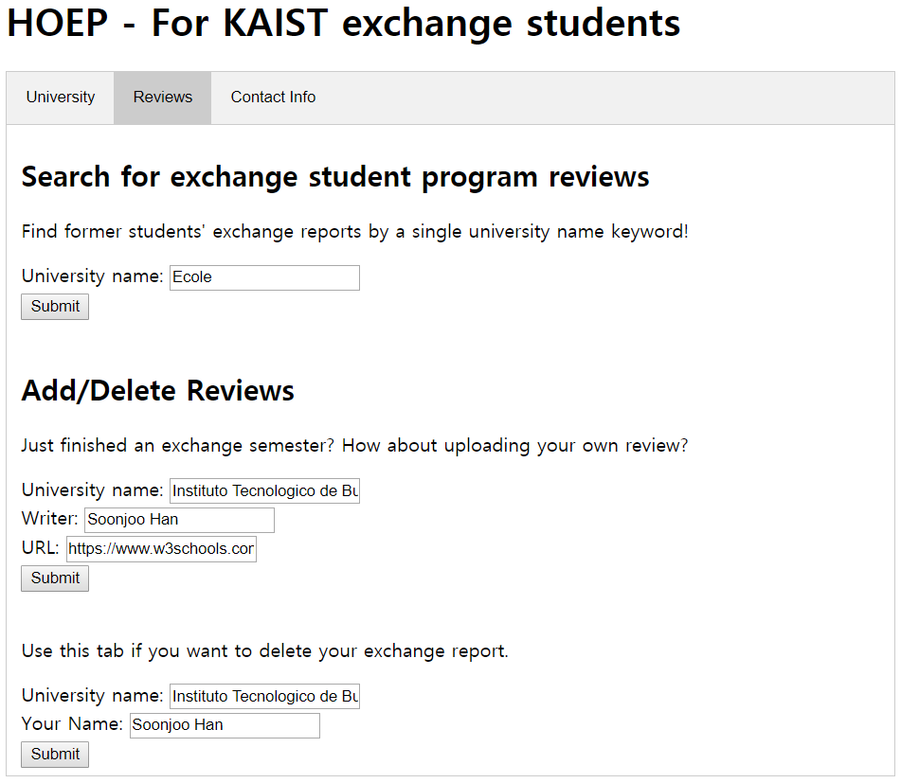
Main tab 2-1
Keyword user input
Univ name, former exchange student, review URL
Notes:
#20. The second function of HOEP is about exchange program reviews. User can either search for reviews or manually add and delete reviews.
First, exchange program reviews can be searched by university name. Review URL is retrieved together with university name and the writer who is former exchange student.

Slide 21
Main tab 2-1
FORMER_EXCHANGE
UID | Univ_name | Name | Date | URL
36 | Technical University of Dortmund | Lee Doyeon | 2018-09-13 | https://io.kaist.ac.kr/part/board_view.do?menuName=Experience Reports&guid=2031d67b-3ab7-e811-940f-2c44fd7df8b9
37 | Technical University of Darmstadt | Lee Jongeun | 2018-09-09 | https://io.kaist.ac.kr/part/board_view.do?menuName=Experience Reports&guid=03bdad82-b1b3-e811-940f-2c44fd7df8b9
13 | Technical University of Denmark | KIM JIN HEE | 2018-09-07 | https://io.kaist.ac.kr/part/board_view.do?menuName=Experience Reports&guid=227d1a65-55b2-e811-940f-2c44fd7df8b9
61 | Linkoping University | lim kihwan | 2018-09-07 | https://io.kaist.ac.kr/part/board_view.do?menuName=Experience Reports&guid=6a70907f-46b2-e811-940f-2c44fd7df8b9
70 | University of Leeds | Park Moon Deok | 2018-09-07 | https://io.kaist.ac.kr/part/board_view.do?menuName=Experience Reports&guid=f26220f0-05b2-e811-940f-2c44fd7df8b9
19 | Ecole Nationale Superieure des Mines de Saint-Etienne | Cha Yongjun | 2018-09-06 | https://io.kaist.ac.kr/part/board_view.do?menuName=Experience Reports&guid=327816f1-d7b1-e811-940f-2c44fd7df8b9
13 | Technical University of Denmark | Shon Hyoung Uk | 2018-09-06 | https://io.kaist.ac.kr/part/board_view.do?menuName=Experience Reports&guid=53b8bb39-c5b1-e811-940f-2c44fd7df8b9
57 | Nanyang Technological University | Cho Jae Han | 2018-09-06 | https://io.kaist.ac.kr/part/board_view.do?menuName=Experience Reports&guid=2adf1bd5-8fb1-e811-940f-2c44fd7df8b9
… | … | … | … | …
Locate university name from user input – LIKE command
Select tuples matching given university name and project
Notes:
#21. Result is obtained by querying FORMER_EXCHANGE table, shown here. University name is selected by user input using “LIKE” command.

Slide 22
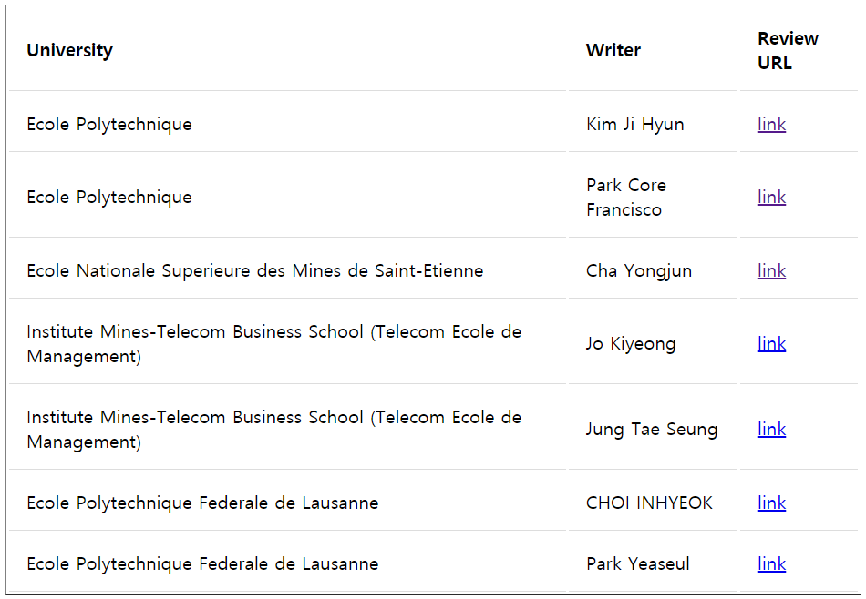
Main tab 2-1
"SELECT Univ_name, Name, URL
FROM FORMER_EXCHANGE
WHERE Univ_name LIKE '%" + req.body.univ+ "%';"
Notes:
This is the SQL command and the screenshot of example result when user searched for “Ecole”. User can see the review by clicking the URL.

Slide 23
Main tab 2-2
User input
Review table modification
Notes:
#23. Adding and Deleting reviews are done by providing university name, writer, URL for adding.

Slide 24
Main tab 2-2
FORMER_EXCHANGE
UID | Univ_name | Name | Date | URL
36 | Technical University of Dortmund | Lee Doyeon | 2018-09-13 | https://io.kaist.ac.kr/part/board_view.do?menuName=Experience Reports&guid=2031d67b-3ab7-e811-940f-2c44fd7df8b9
37 | Technical University of Darmstadt | Lee Jongeun | 2018-09-09 | https://io.kaist.ac.kr/part/board_view.do?menuName=Experience Reports&guid=03bdad82-b1b3-e811-940f-2c44fd7df8b9
13 | Technical University of Denmark | KIM JIN HEE | 2018-09-07 | https://io.kaist.ac.kr/part/board_view.do?menuName=Experience Reports&guid=227d1a65-55b2-e811-940f-2c44fd7df8b9
61 | Linkoping University | lim kihwan | 2018-09-07 | https://io.kaist.ac.kr/part/board_view.do?menuName=Experience Reports&guid=6a70907f-46b2-e811-940f-2c44fd7df8b9
70 | University of Leeds | Park Moon Deok | 2018-09-07 | https://io.kaist.ac.kr/part/board_view.do?menuName=Experience Reports&guid=f26220f0-05b2-e811-940f-2c44fd7df8b9
19 | Ecole Nationale Superieure des Mines de Saint-Etienne | Cha Yongjun | 2018-09-06 | https://io.kaist.ac.kr/part/board_view.do?menuName=Experience Reports&guid=327816f1-d7b1-e811-940f-2c44fd7df8b9
13 | Technical University of Denmark | Shon Hyoung Uk | 2018-09-06 | https://io.kaist.ac.kr/part/board_view.do?menuName=Experience Reports&guid=53b8bb39-c5b1-e811-940f-2c44fd7df8b9
57 | Nanyang Technological University | Cho Jae Han | 2018-09-06 | https://io.kaist.ac.kr/part/board_view.do?menuName=Experience Reports&guid=2adf1bd5-8fb1-e811-940f-2c44fd7df8b9
… | … | … | … | …
Locate university id from user input – LIKE command (UNIVERSITY table)
Further insert / delete operations on FORMER_EXCHANGE table
Notes:
#24. This time, university name is searched in UNIVERSITY table, to guarantee the review is about one of the valid university.
Using the searched university_name and UID, we can insert to or delete from FORMER_EXCHANGE table.

Slide 25
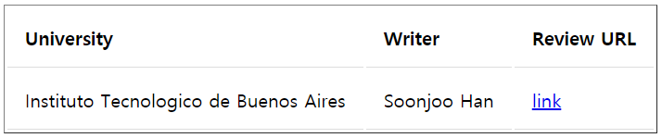

Main tab 2-2
Insertion
"SELECT UID, Name
FROM UNIVERSITY
WHERE Name LIKE '%"+req.body.univ+"%'";
uid = rows[0].UID;univName = rows[0].univName;
"INSERT INTO FORMER_EXCHANGE
VALUES ("+uid +", '"+univName+"', '"+req.body.author+"', '"+today+"', '"+req.body.URL+"')";
Locate university id from user input
Notes:
#25. For insertion, using the SQL command in green box, we found UID of the table. If result has more than 1 rows or no rows, we showed alert page requesting new input.
If one uid and university name is retrieved, it is inserted into FORMER_EXCHANGE table with today’s date and input writer and URL.

Slide 26
Main tab 2-2
Deletion
"SELECT UID, Name
FROM UNIVERSITY
WHERE Name LIKE '%"+req.body.univ+"%'";
uid = rows[0].UID;
"DELETE FROM FORMER_EXCHANGE
WHERE UID = '" + uid + "' and Name = " + req.body.author + "';"
Locate university id from user input
Notes:
#26. For deletion, UID and Name are retrieved likewise as in insertion. As FORMER_EXCHANGE has primary key UID and writer’s name, we use those two attribute to delete the row from FORMER_EXCAHNGE.

Slide 27
Main tab 2-2
Input validity check
Ensuring entity integrity constraint (insertion) or checking if there’s no matching tuple (deletion)
(Code not shown)
Notes:
Before insertion and deletion, the validity of input is checked. In insertion, we check if primary key of row to be inserted do not duplicate with preexisting rows. In deletion, we check if there exists a matching tuple. If input is invalid, alert page requesting input check is shown. If input is valid, success page notifies the modification is correctly applied.

Slide 28
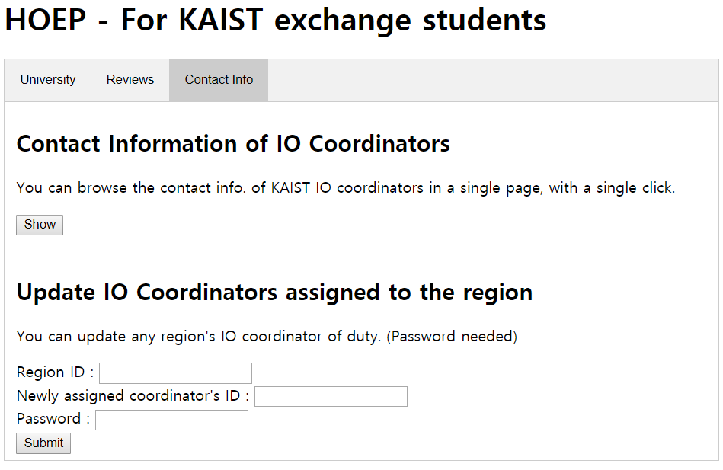
Main tab 3-1
Visualize
whole relationship

Slide 29
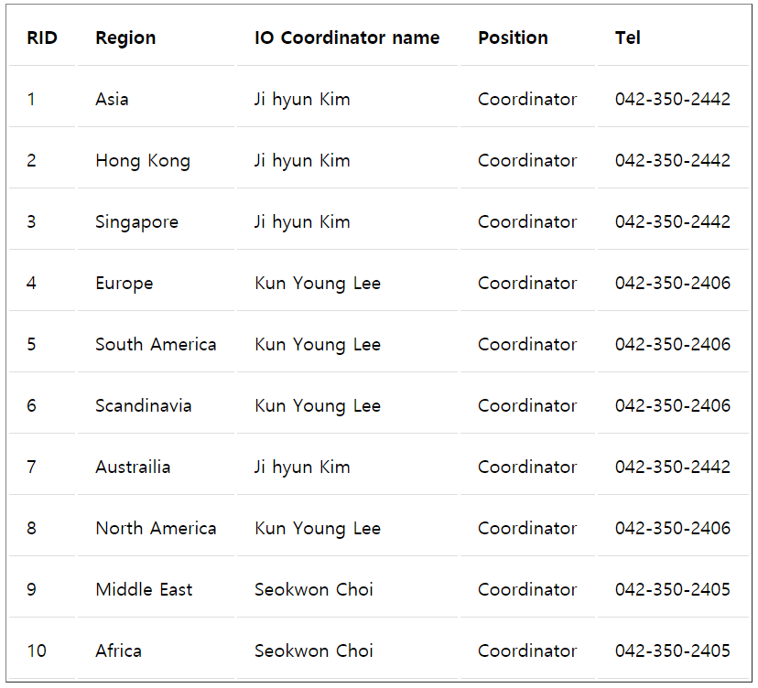
Main tab 3-1
CREATE VIEW REGION_COORD AS
SELECT …
FROM REGION JOIN IO_COORDINATOR USING(CID);
"SELECT *
FROM REGION_COORD;"

Slide 30
Main tab 3-1
REGION
IO_COORDINATOR
RID | Region | KAIST_scholarship | CID
1 | Asia | 1500000 | 6
2 | Hong Kong | 1700000 | 6
3 | Singapore | 1700000 | 6
4 | Europe | 2500000 | 3
5 | South America | 2500000 | 3
6 | Scandinavia | 2750000 | 3
7 | Austrailia | 2750000 | 6
8 | North America | 2750000 | 3
9 | Middle East | 0 | 8
10 | Africa | 0 | 8
CID | Name | Position | Tel
1 | Eunjae Lee | Manager | 042-350-2449
2 | Moonsung Kim | Senior Coordinator | 042-350-2407
3 | Kun Young Lee | Coordinator | 042-350-2406
4 | Sejin Nam | Coordinator | 042-350-2441
5 | Jee Soo Lim | Coordinator | 042-350-2447
6 | Ji hyun Kim | Coordinator | 042-350-2442
7 | MiRan An | Coordinator | 042-350-2444
8 | Seokwon Choi | Coordinator | 042-350-2405
9 | Seung Hyun Sohn | Coordinator | 042-350-2443
Joining each time at demand is ineffective
Join and project -> make view table
CREATE VIEW REGION_COORD AS
SELECT REGION.RID, REGION.Region,
IO_COORDINATOR.Name,
IO_COORDINATOR.Position,
IO_COORDINATOR.Tel
FROM REGION JOIN IO_COORDINATOR USING(CID);

Slide 31
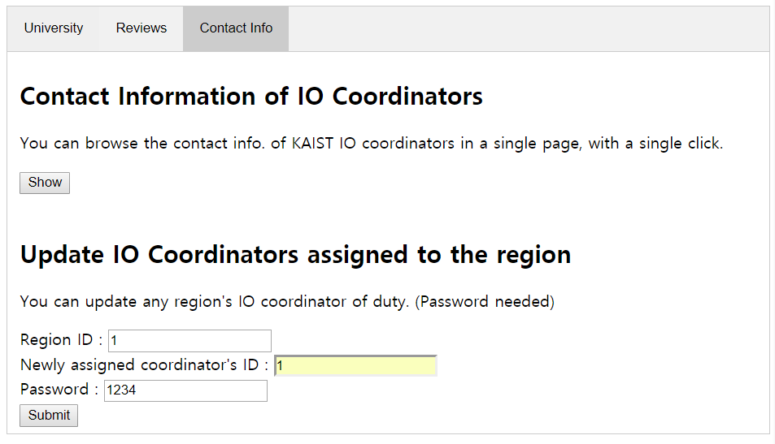
Main tab 3-2
User input
REGION table update

Slide 32
Main tab 3-2
REGION
RID | Region | KAIST_scholarship | CID
1 | Asia | 1500000 | 6
2 | Hong Kong | 1700000 | 6
3 | Singapore | 1700000 | 6
4 | Europe | 2500000 | 3
5 | South America | 2500000 | 3
6 | Scandinavia | 2750000 | 3
7 | Austrailia | 2750000 | 6
8 | North America | 2750000 | 3
9 | Middle East | 0 | 8
10 | Africa | 0 | 8
(IO_COORDINATOR)
CID | Name | Position | Tel
1 | Eunjae Lee | Manager | 042-350-2449
2 | Moonsung Kim | Senior Coordinator | 042-350-2407
3 | Kun Young Lee | Coordinator | 042-350-2406
4 | Sejin Nam | Coordinator | 042-350-2441
5 | Jee Soo Lim | Coordinator | 042-350-2447
6 | Ji hyun Kim | Coordinator | 042-350-2442
7 | MiRan An | Coordinator | 042-350-2444
8 | Seokwon Choi | Coordinator | 042-350-2405
9 | Seung Hyun Sohn | Coordinator | 042-350-2443
Tuple identification by given RID (WHERE)
CID update (SET)
"UPDATE Region
SET CID = "+req.body.coord_CID+"
WHERE RID = "+req.body.region_CID+";";

Slide 33
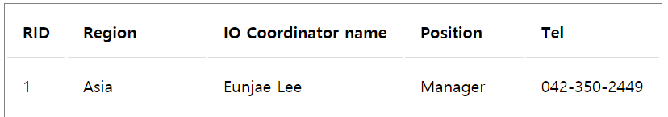
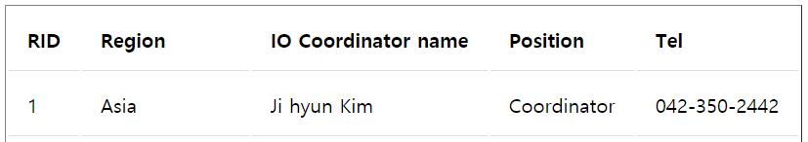
Main tab 3-2
Update result

Slide 34
Main tab 3-2
Input validity & authority (password) check
(Code not shown)

Slide 35
Conclusion
Our implemented service provides functions below
Search partner univ. by related KAIST dept and preferred region
Browse specific univ. information in a single page
Check language requirement and former reviews by a single keyword
Browse and maintain KAIST IO manager information
Capable of helping pre-exchange students in choosing their partner university

Slide 36
Project requirement sheet
Basic requirements
Use MySQL DBMS -> Done!
Provide a web interface -> Done!
Operation requirements
Selection and projection -> Done!
Insert -> Done!
Join -> Done!
Subquery -> Done!
Aggregation -> Done!
Optional
View or trigger (view) -> Done!

